Slide 1

Layers of Web Development

Slide 2
program
algorithm
algorithm
algorithm

Slide 3
Web application
program
program
program
algorithm
algorithm
algorithm
algorithm
algorithm
algorithm

Slide 4
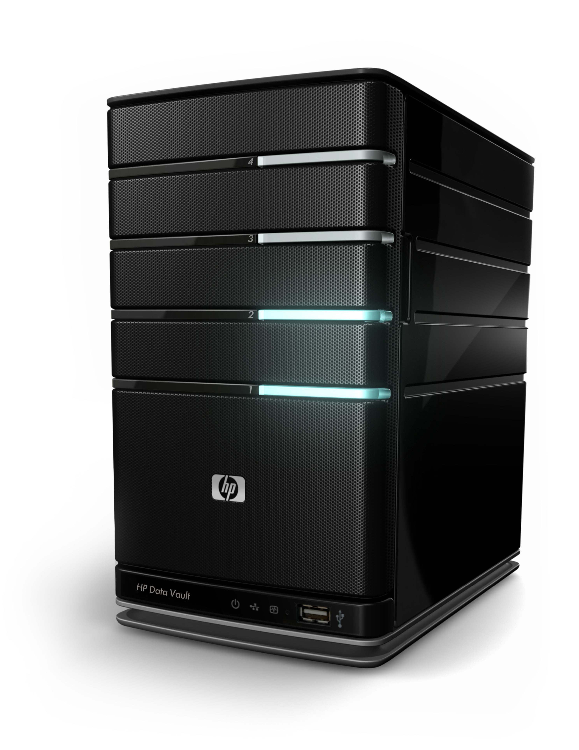
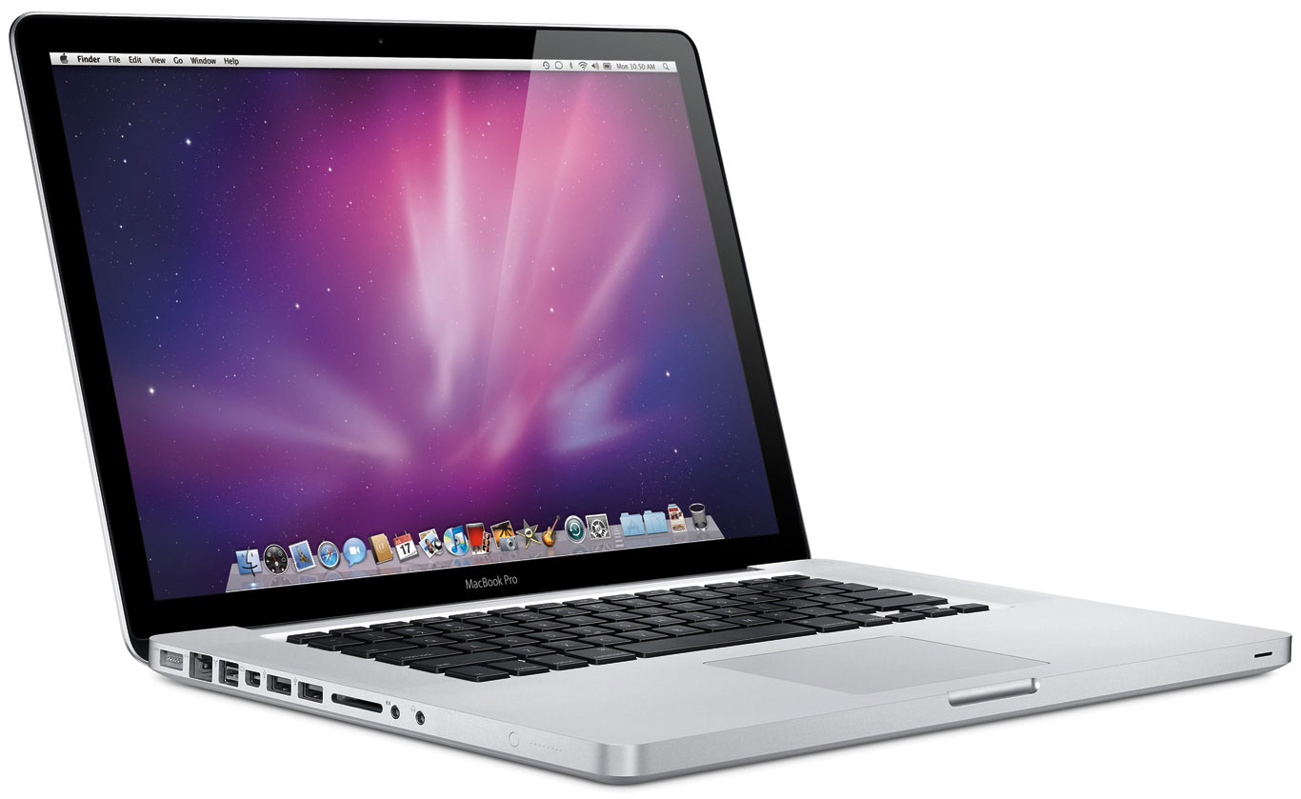

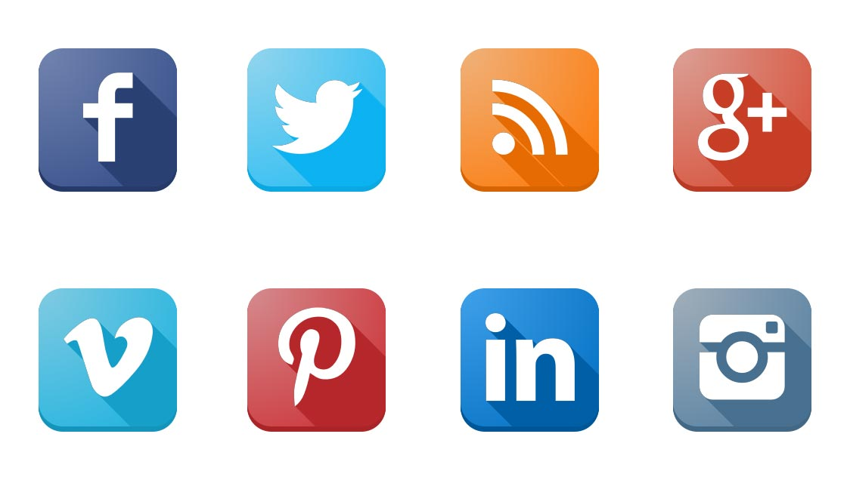
client
server
database
APIs

Slide 5
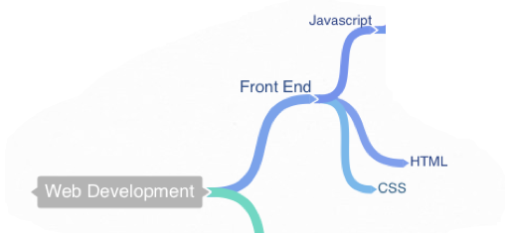
Client
The user's computer
Specifically on a web browser or some other program that makes network requests.
What does the website look like? (HTML/CSS)
What happens when I click this button? (JS)

Slide 6
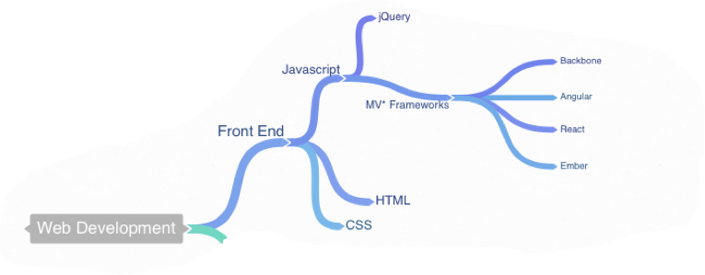
Front-end Frameworks
Some JavaScript packages to make writing web apps easier, more performant, and more secure.

Slide 7
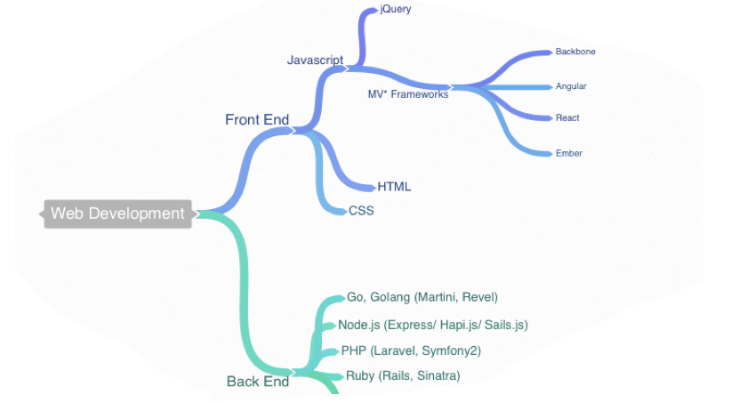
Server
Some other computer somewhere...
“Business logic.” Is that password correct?
Who is authorized to do what? Should I redirect?
What are they buying? Is there a sale on this item?

Slide 8
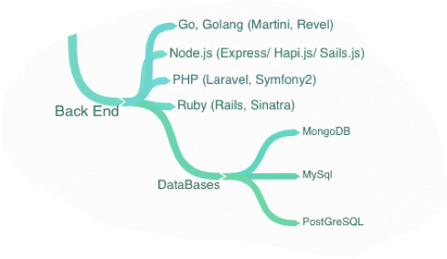
Database
Yet another computer somewhere...
What is the actual data?
Who are you friends with? What does your comment say? etc.

Slide 9
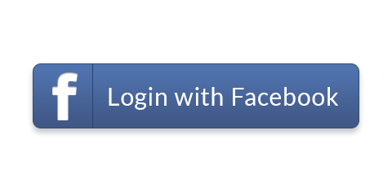
APIs
External servers.
Facebook, Instagram, Twitter, etc..

Slide 10


